Slide 1
Overlay Networks
Xin Jin
Fall 2019 (TTh 1:30-2:45 in Hodson 316)
EN.601.714 Advanced Computer Networks
https://github.com/xinjin/course-adv-net

Slide 2
The Start:
Sean Parker
File-sharing service for music
Launched in June 1999
Had tens of millions of users in one year
Revolutionized the music industry, precursor of iTunes

Slide 3
The Facebook -> Facebook
The Social Network

Slide 4
Now the papers…

Slide 5
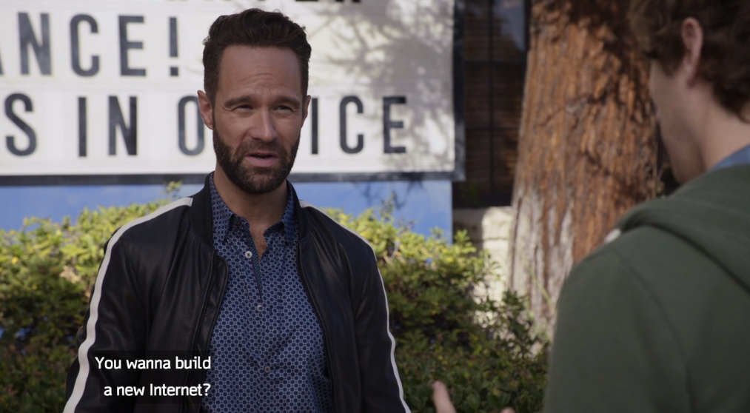
And then, the new Internet…
Notes:
HBO Silicon Valley

Slide 6
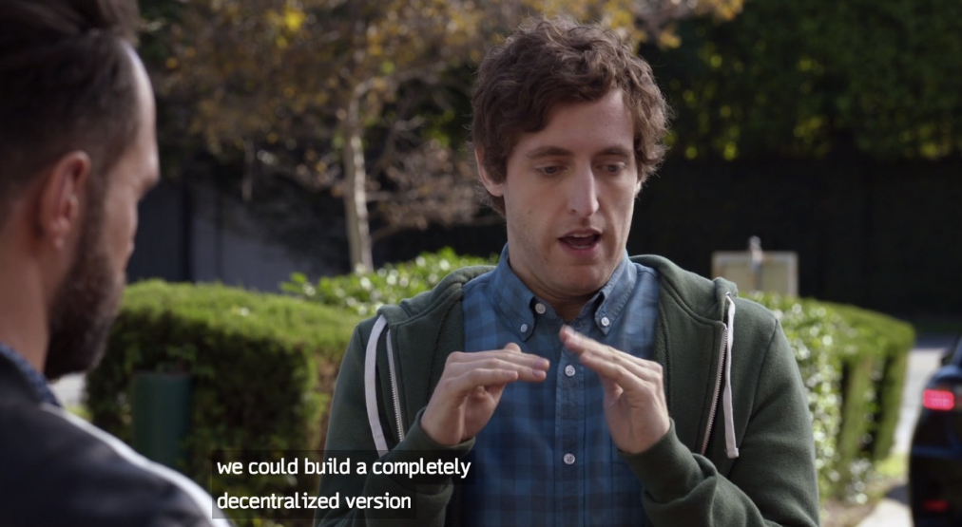
And then, the new Internet…

Slide 7
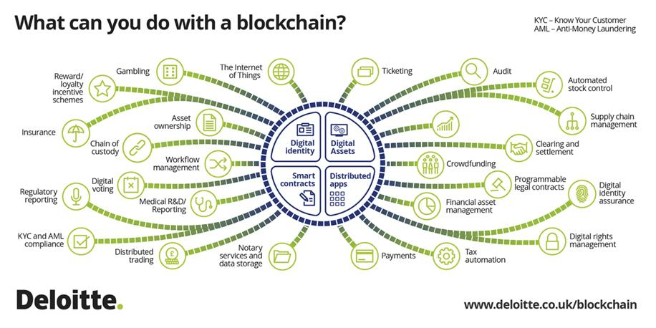
And then, the new Internet…
Blockchain enables a new generation of decentralized Internet applications
Bitcoin is only one of them
Still a hype…

Slide 8
Overlay Networks -> Today?
Major challenge: scalability (routing)
Scale: millions or billions of keys
Constraint: limited resource to host routing tables
Does this still apply to today’s scenario?
1 thousand keys* 4 bytes/key = 4 KB
1 million keys* 4 bytes/key = 4 MB
1 billion keys* 4 bytes/key = 4 GB
Useful properties: scalability (storage), load balance, fault-tolerance

Slide 9
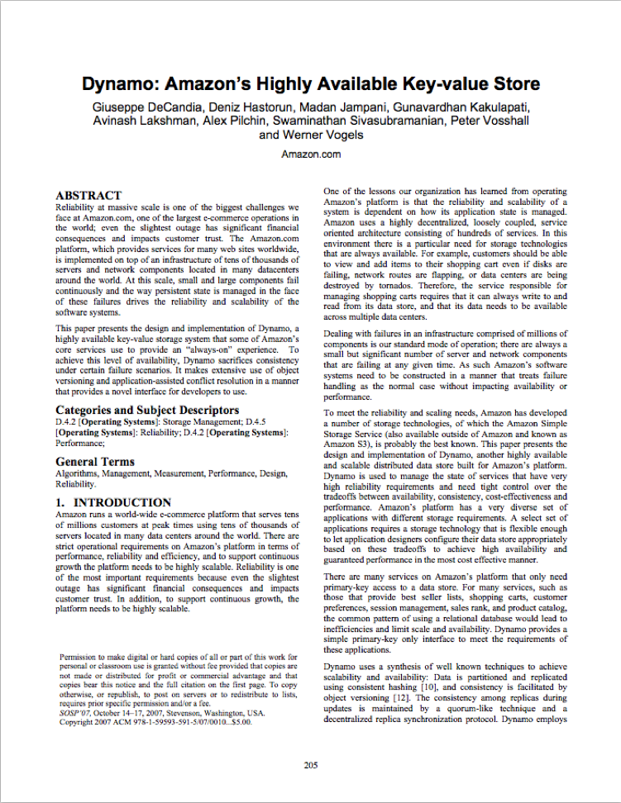
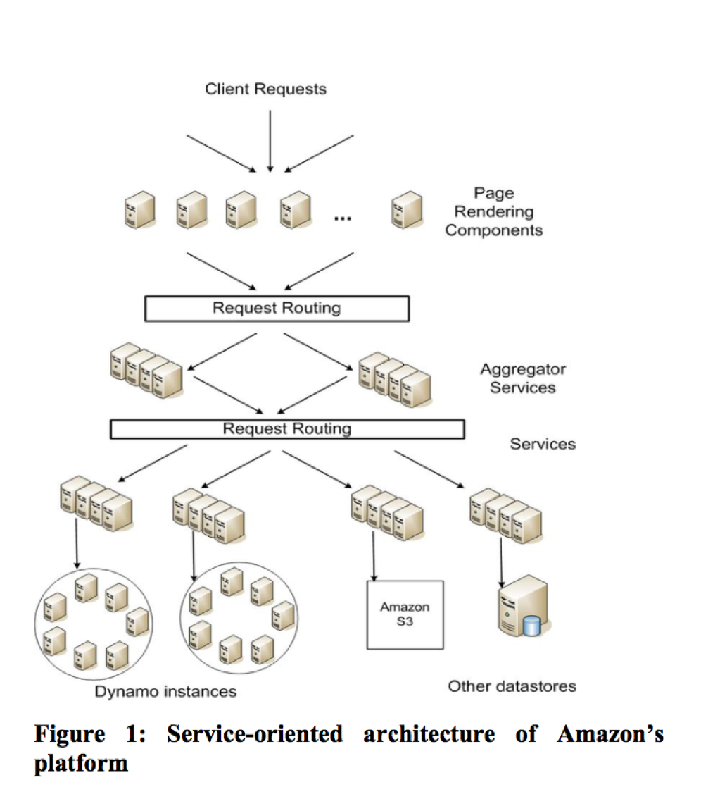
Past: Overlay Networks -> Today: Distributed Storage

Slide 10
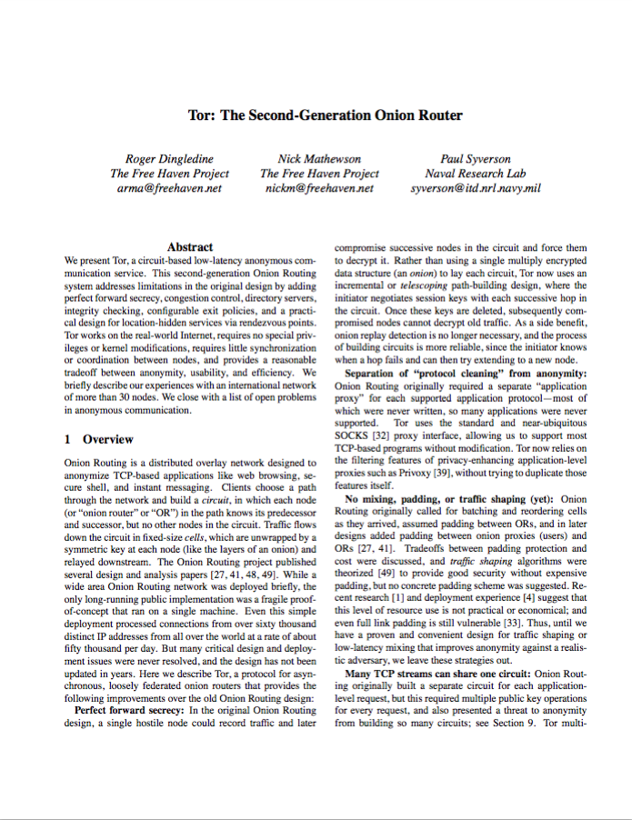
Past: Overlay Networks -> Today: Anonymous Networks

Slide 19
Thanks! Q&A

